Slide 1
Perspectives on using deep learning for system health management
Samir Khan, Takehisa Yairi
Artificial Intelligence Group
University of Tokyo
PHM2017
12-14 July 2017

Slide 2
Agenda
Advances in the field
Some theory…
What does this all mean?
Future trends

Slide 3
Advances in related fields
The ability to collect, store, and operate over large amounts of data has greatly advanced over the last decade (for instance, the Apache Hadoop Ecosystem).
The ability to generate supervised training data (which is basically data with labels—an example of this would be pictures annotated with the objects in the picture) has improved a lot with the availability of crowd-sourcing services (like Amazon Mechanical Turk).
The massive improvements in computational horsepower brought about by Graphical Processor Units.
The advances in both theory and software implementation of automatic differentiation (like Theano).

Slide 4
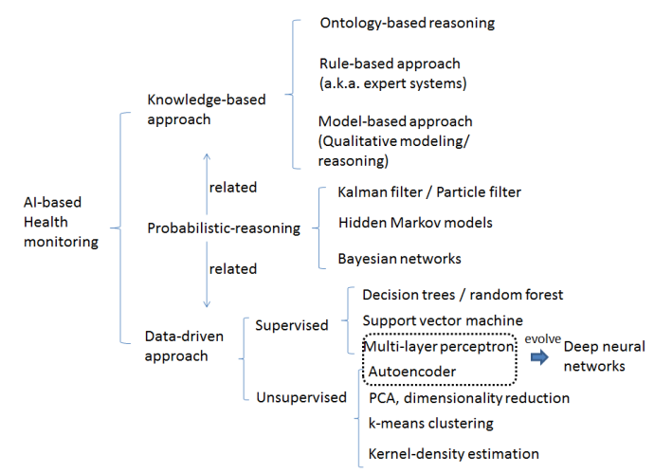
Advances in related fields
While these advancements are peripheral to any type of learning, they have played a big role for advancing data-driven approaches.

Slide 5
Advances in related fields
While these advancements are peripheral to any type of learning, they have played a big role for advancing data-driven approaches.
What is deep learning?

Slide 6
Advances in related fields
While these advancements are peripheral to any type of learning, they have played a big role for advancing data-driven approaches.
What is deep learning?
How do we apply it?

Slide 7
Advances in related fields
While these advancements are peripheral to any type of learning, they have played a big role for advancing data-driven approaches.
What is deep learning?
How do we apply it?
How easy is it to implement?

Slide 8
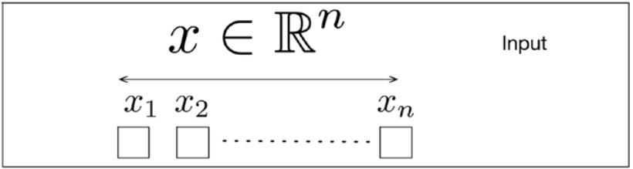

Slide 9
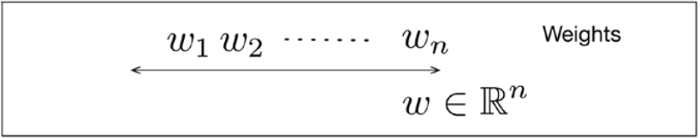

Slide 10
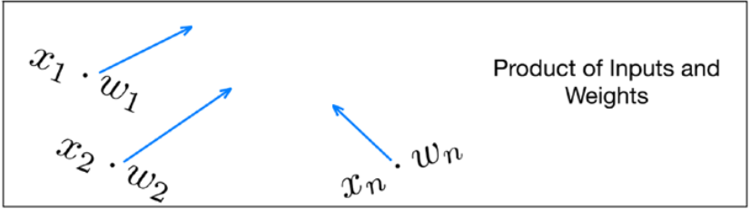
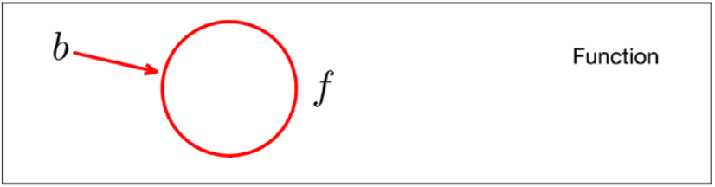

Slide 11
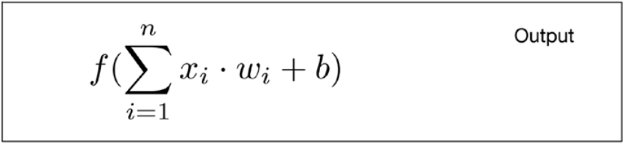

Slide 12
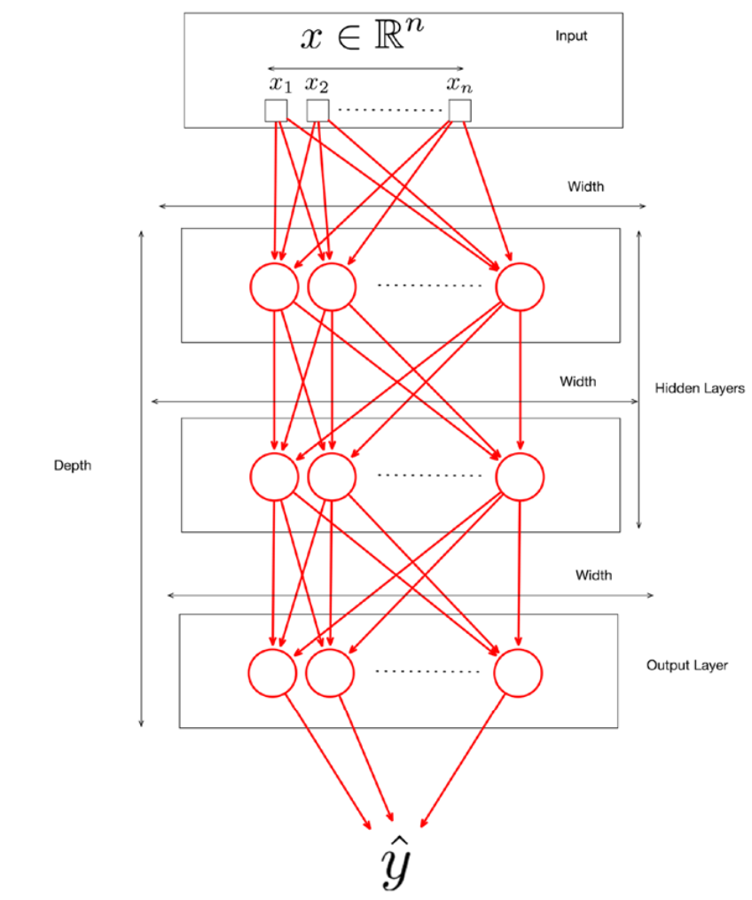

Slide 13
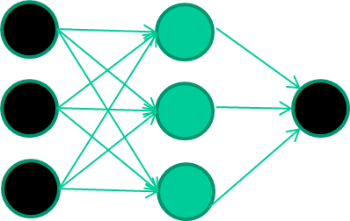
Deep learning
Initialise with random weights
Present a training pattern
Feed it through to get output
Compare with target output
Adjust weights based on error,
eg, using back propagation algo
Repeat this process many times making slight adjustments
and reduce the error

Slide 14
In a decision boundary sense…
Initial random weights

Slide 15
In a decision boundary sense…
Carry out training and adjust weights…

Slide 16
In a decision boundary sense…
Carry out training and adjust weights…

Slide 17
In a decision boundary sense…
Carry out training and adjust weights…

Slide 18
In a decision boundary sense…
Carry out training and adjust weights…

Slide 19
In a decision boundary sense…
Carry out training and adjust weights…

Slide 20
How many layers?
Deep learning works because of the architecture of the network but..
It is the optimization routine applied to that architecture that makes the difference
Consider how an autoencoder work…

Slide 21
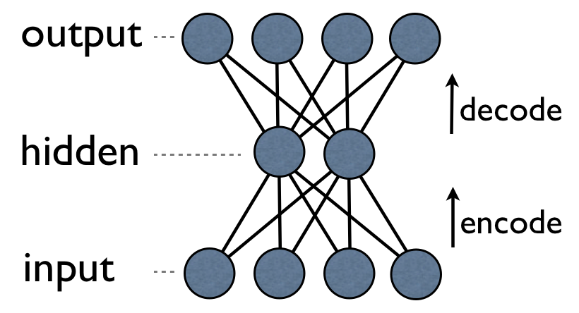
Autoencoders
Autoencoders reproduce the inputs. By making this happen,
the hidden layer becomes good feature extractors

Slide 22
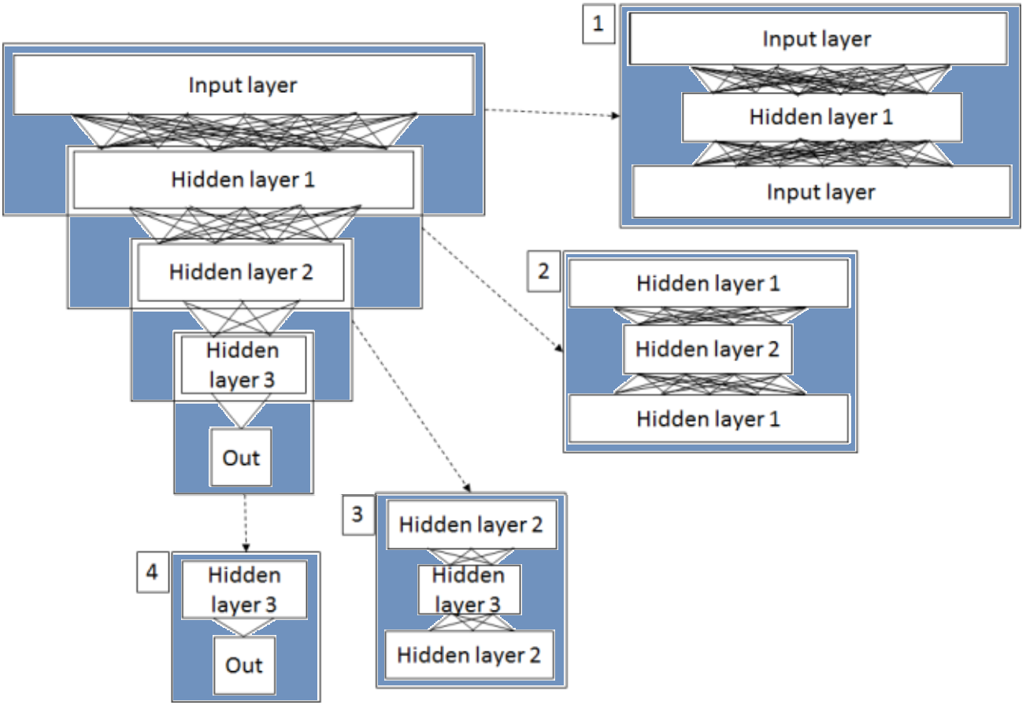
Autoencoders

Slide 23
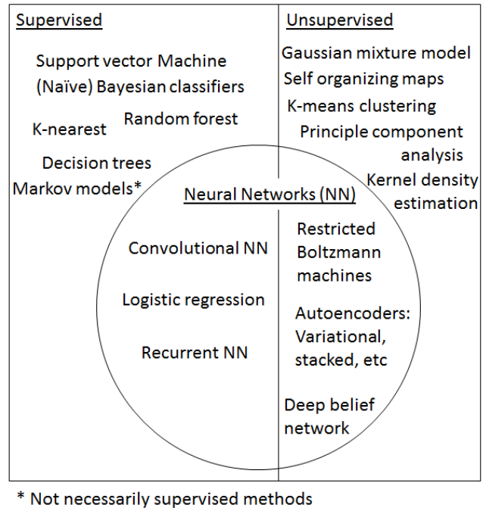
Techniques considered for deep learning

Slide 24
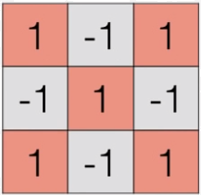
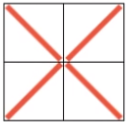

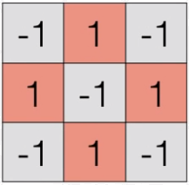
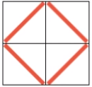

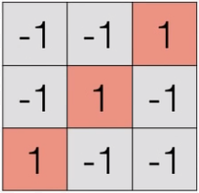
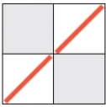

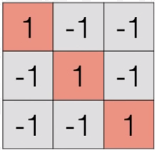
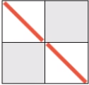

Convolutional neural networks
Covolutional layer
Pooling layer
Fully connected layer

Slide 25
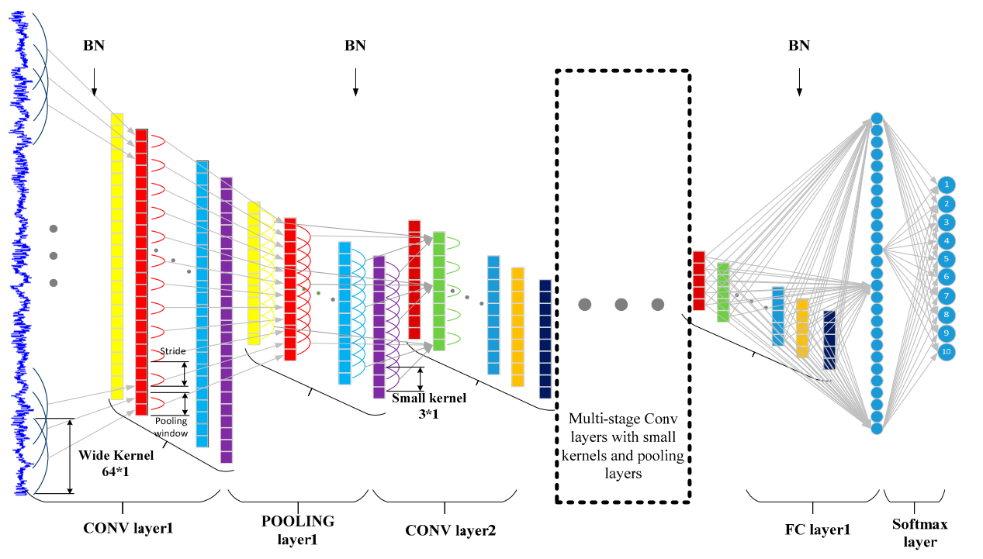
Convolutional neural networks
Wei Zhang, Gaoliang Peng, Chuanhao Li, Yuanhang Chen and Zhujun Zhang . A New Deep Learning Model for Fault Diagnosis with Good Anti-Noise and Domain Adaptation Ability on Raw Vibration Signals Sensors 2017, 17, 425; doi:10.3390/s17020425

Slide 26
What does this mean
Deep Learning is subjective to its application and discipline
It may return limited benefits when used for time series analysis as compared to its application in pattern recognition. Perhaps a greater CPU energy consumption does not justify its use
The problem of complexity

Slide 27
What does this mean
Deep Learning is subjective to its application and discipline
It may return limited benefits when used for time series analysis as compared to its application in pattern recognition. Perhaps a greater CPU energy consumption does not justify its use
The problem of complexity
Health management comprises of: fault detection, fault classification and fault prediction

Slide 28
What does this mean
Deep Learning is subjective to its application and discipline…
But since feature design, feature extraction/selection and model training can not be jointly optimized which may hinder the final performance of the whole system
Health management comprises of: fault detection, fault classification and fault prediction
Deep learning models have several variants so the problem of complexity…

Slide 29
What does this mean
Hand design features
-RMS
-Variance
-Peaks
-etc
Feature selection methods
-PCA
-ICA
Model training
-SVM
-Random forest
-NN
Feature selection methods
-PCA
-ICA
Data sources
Data acquisition
Targets
Conventional data driven
Data sources
Data acquisition
From simple features to abstract features
Softmax/
regression
Targets
Deep learning based

Slide 30
Autoencoders
Used to learn high-level representations from machinery data | Sun et al (2016)
Stacked denoising autoencoders with three hidden layers used for fault diagnosis of rotary machinery components | Lu et al (2017)
Two-layer SAE were used and evaluated for their performances in fault diagnosis | S. Tao at al (2015)
Used the frequency spectra of time-series data into SAE for rotating machinery diagnosis | Jia et al. (2016)
digital wavelet frame and nonlinear soft threshold method to process the vibration signal and built a SAE on the preprocessed signal for roller bearing fault diagnosis | Jia et al. (2016)
SAE for hydraulic pump fault diagnosis with input as frequency domain features after Fourier transform | Zhu et al. (2015)

Slide 31
Convolutional
built a 2D deep convolution neural network to predict the RUL of system based on normalizedvariate time series from sensor signals | Babu et al (2016)
wavelet packet energy (WPE) image were used as input for spindle bearing fault diagnosis | Ding et al (2017)
a hierarchical adaptive deep convolution neural network | Guo et al (2016)
enhanced CNN was proposed for machinery fault diagnosis by pre-processing vibration data, decomposed by morlet wavelet to obtain wavelet scaleogram. | Wnag et al (2016)
study of various design configurations of deep CNN for visual defect detection | Weimer et al (2016)
applied in the field of diagnosing the early small faults of front-end controlled wind generator | Dong et al (2016)

Slide 32
Future trends
Deep learning is not a skeleton key to all machine health monitoring problems.
There are essentially black boxes models, i.e., their inner computation mechanisms are unexplainable so some kind of visualisation…?
Transfer learning to other domains
It is difficult to assess whether it will be in the academic frontier in upcoming years
A number of technology organizations are pushing for solutions

Slide 33
Moving knowledge from Computer science
Many engineer may lack the knowledge to develop further deep learning architectures
Libraries, optimisers found in Matlab seem outdated for novel deep learning algorithms – but excellent for time series analysis
Libraries in Theano such as Tensorflow are much more capable and simple

Slide 34
Summary
A brief description of deep learning
A lot more work is required for time series analysis
Automatic differentiation is an advantage – express a lot of complicated data
End-to-end learning

